Slide 1

Chapter 8
Confidence Interval Estimation

Slide 2
Objectives
In this chapter, you learn:
To construct and interpret confidence interval estimates for the population mean and the population proportion
To determine the sample size necessary to develop a confidence interval for the population mean or population proportion

Slide 3
Chapter Outline
Content of this chapter
Confidence Intervals for the Population Mean, μ
  when Population Standard Deviation σ is Known
  when Population Standard Deviation σ is Unknown
Confidence Intervals for the Population Proportion, π
Determining the Required Sample Size

Slide 4
Point and Interval Estimates
DCOVA
A point estimate is a single number,
a confidence interval provides additional information about the variability of the estimate
Lower
Confidence
Limit
Upper
Confidence
Limit
Point Estimate
Width of
confidence interval

Slide 5
Point Estimates
DCOVA
We can estimate a
Population Parameter …
with a Sample
Statistic
(a Point Estimate)
Mean
μ
X
Proportion
π
p

Slide 6
Confidence Intervals
DCOVA
How much uncertainty is associated with a point estimate of a population parameter?
An interval estimate provides more information about a population characteristic than does a point estimate
Such interval estimates are called confidence intervals

Slide 7
Confidence Interval Estimate
DCOVA
An interval gives a range of values:
  Takes into consideration variation in sample statistics from sample to sample
  Based on observations from 1 sample
  Gives information about closeness to unknown population parameters
  Stated in terms of level of confidence
    e.g. 95% confident, 99% confident
    Can never be 100% confident

Slide 8

Confidence Interval Example
DCOVA
Cereal fill example
Population has µ = 368 and σ = 15.
If you take a sample of size n = 25 you know
  368 ± 1.96 * 15 / = (362.12, 373.88). 95% of the intervals formed in this manner will contain µ.
  When you don’t know µ, you use X to estimate µ
    If X = 362.3 the interval is 362.3 ± 1.96 * 15 / = (356.42, 368.18)
    Since 356.42 ≤ µ ≤ 368.18 the interval based on this sample makes a correct statement about µ.
But what about the intervals from other possible samples of size 25?

Slide 9
Confidence Interval Example
(continued)
DCOVA
Sample # | X | Lower Limit | Upper Limit | Contain µ?
1 | 362.30 | 356.42 | 368.18 | Yes
2 | 369.50 | 363.62 | 375.38 | Yes
3 | 360.00 | 354.12 | 365.88 | No
4 | 362.12 | 356.24 | 368.00 | Yes
5 | 373.88 | 368.00 | 379.76 | Yes

Slide 10
Confidence Interval Example
(continued)
DCOVA
In practice you only take one sample of size n
In practice you do not know µ so you do not know if the interval actually contains µ
However you do know that 95% of the intervals formed in this manner will contain µ
Thus, based on the one sample, you actually selected you can be 95% confident your interval will contain µ (this is a 95% confidence interval)
Note: 95% confidence is based on the fact that we used Z = 1.96.

Slide 11
Estimation Process
DCOVA
Random Sample
I am 95% confident that μ is between 40 & 60.
Population
Mean
X = 50
(mean, μ, is unknown)
Sample

Slide 12
General Formula
DCOVA
The general formula for all confidence intervals is:
Point Estimate ± (Critical Value)(Standard Error)
Where:
    Point Estimate is the sample statistic estimating the population parameter of interest
    Critical Value is a table value based on the sampling distribution of the point estimate and the desired confidence level
    Standard Error is the standard deviation of the point estimate

Slide 13
Confidence Level
DCOVA
Confidence the interval will contain the unknown population parameter
A percentage (less than 100%)

Slide 14
Confidence Level, (1-α)
(continued)
DCOVA
Suppose confidence level = 95%
Also written (1 - α) = 0.95, (so α = 0.05)
A relative frequency interpretation:
  95% of all the confidence intervals that can be constructed will contain the unknown true parameter
A specific interval either will contain or will not contain the true parameter
  No probability involved in a specific interval

Slide 15
Confidence Intervals
DCOVA
Confidence
Intervals
Population
Mean
Population
Proportion
σ Known
σ Unknown

Slide 16
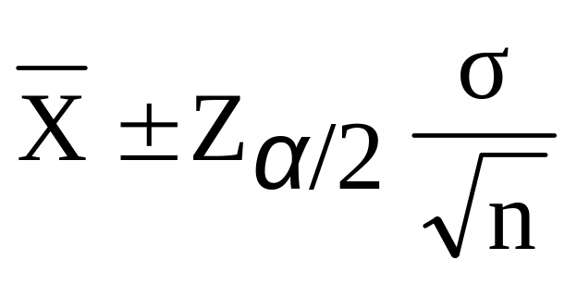


Confidence Interval for μ
(σ Known)
DCOVA
Assumptions
  Population standard deviation σ is known
  Population is normally distributed
  If population is not normal, use large sample (n > 30)
Confidence interval estimate:
where is the point estimate
Z_{α/2} is the normal distribution critical value for a probability of α/2 in each tail
is the standard error

Slide 17
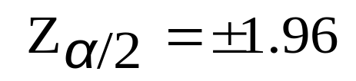

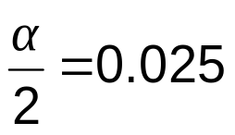
Finding the Critical Value, Z_{α/2}
DCOVA
Consider a 95% confidence interval:
Z units:
Z_{α/2} = -1.96
0
Z_{α/2} = 1.96
X units:
Lower
Confidence
Limit
Upper
Confidence
Limit
Point Estimate
Point Estimate

Slide 18

Common Levels of Confidence
DCOVA
Commonly used confidence levels are 90%, 95%, and 99%
Confidence Coefficient,
Confidence Level
Z_{α/2} value
80%
90%
95%
98%
99%
99.8%
99.9%
0.80
0.90
0.95
0.98
0.99
0.998
0.999
1.28
1.645
1.96
2.33
2.58
3.08
3.27

Slide 19



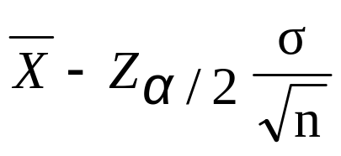
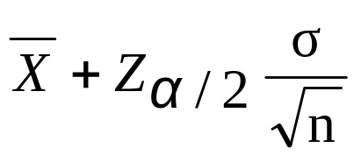
Intervals and Level of Confidence
DCOVA
Sampling Distribution of the Mean
x
Intervals extend from
to
x₁
x₂
(1-α)100%
of intervals constructed contain μ;
(α)100% do not.
Confidence Intervals

Slide 20

Example
DCOVA
A sample of 11 circuits from a large normal population has a mean resistance of 2.20 ohms. We know from past testing that the population standard deviation is 0.35 ohms.
Determine a 95% confidence interval for the true mean resistance of the population.

Slide 21
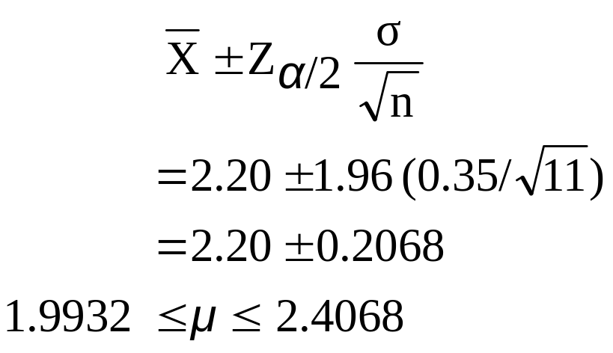

Example
DCOVA
(continued)
A sample of 11 circuits from a large normal population has a mean resistance of 2.20 ohms. We know from past testing that the population standard deviation is 0.35 ohms.
Solution:

Slide 22
Interpretation
DCOVA
We are 95% confident that the true mean resistance is between 1.9932 and 2.4068 ohms
Although the true mean may or may not be in this interval, 95% of intervals formed in this manner will contain the true mean

Slide 23
Confidence Intervals
DCOVA
Confidence
Intervals
Population
Mean
Population
Proportion
σ Known
σ Unknown

Slide 24
Do You Ever Truly Know σ?
Probably not!
In virtually all real world business situations, σ is not known.
If there is a situation where σ is known then µ is also known (since to calculate σ you need to know µ.)
If you truly know µ there would be no need to gather a sample to estimate it.

Slide 25
Confidence Interval for μ
(σ Unknown)
DCOVA
If the population standard deviation σ is unknown, we can substitute the sample standard deviation, S
This introduces extra uncertainty, since S is variable from sample to sample
So we use the t distribution instead of the normal distribution

Slide 26
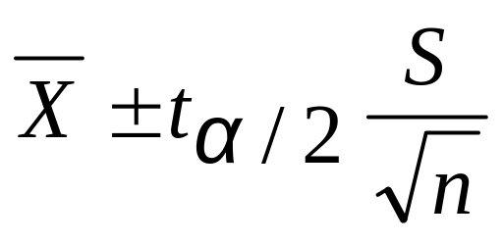
Confidence Interval for μ
(σ Unknown)
(continued)
DCOVA
Assumptions
  Population standard deviation is unknown
  Population is normally distributed
  If population is not normal, use large sample (n > 30)
Use Student’s t Distribution
Confidence Interval Estimate:
(where t_{α/2} is the critical value of the t distribution with n -1 degrees of freedom and an area of α/2 in each tail)

Slide 27
Student’s t Distribution
DCOVA
The t is a family of distributions
The t_{α/2} value depends on degrees of freedom (d.f.)
  Number of observations that are free to vary after sample mean has been calculated
d.f. = n - 1

Slide 28
Degrees of Freedom (df)
DCOVA
  Idea: Number of observations that are free to vary
  after sample mean has been calculated
  Example: Suppose the mean of 3 numbers is 8.0
    Let X₁ = 7
    Let X₂ = 8
    What is X₃?
If the mean of these three values is 8.0,
then X₃ must be 9
(i.e., X₃ is not free to vary)
Here, n = 3, so degrees of freedom = n – 1 = 3 – 1 = 2
(2 values can be any numbers, but the third is not free to vary for a given mean)

Slide 29
Student’s t Distribution
DCOVA
Note: t Z as n increases
Standard Normal
(t with df = ∞)
t (df = 13)
t-distributions are bell-shaped and symmetric, but have ‘fatter’ tails than the normal
t (df = 5)
t
0

Slide 30
Student’s t Table
DCOVA
Upper Tail Area
Let: n = 3
df = n - 1 = 2
α = 0.10
α/2 = 0.05
df
.10
.05
.025
1
3.078
6.314
12.706
2
1.886
2.920
4.303
3
1.638
2.353
3.182
α/2 = 0.05
The body of the table contains t values, not probabilities
0
2.920
t

Slide 31
Selected t distribution values
DCOVA
With comparison to the Z value
Confidence t t t Z
Level (10 d.f.) (20 d.f.) (30 d.f.) (∞ d.f.)
0.80 1.372 1.325 1.310 1.28
0.90 1.812 1.725 1.697 1.645
0.95 2.228 2.086 2.042 1.96
0.99 3.169 2.845 2.750 2.58
Note: t Z as n increases

Slide 32
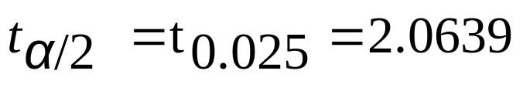
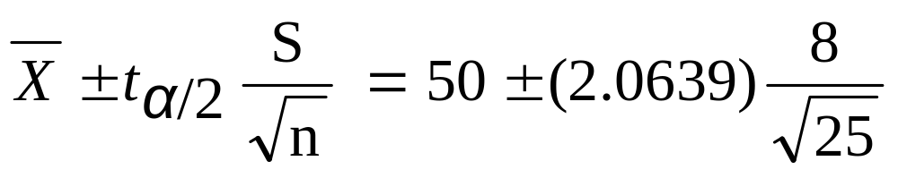
Example of t distribution confidence interval
DCOVA
A random sample of n = 25 has X = 50 and
S = 8. Form a 95% confidence interval for μ
  d.f. = n – 1 = 24, so
  The confidence interval is
46.698 ≤ μ ≤ 53.302

Slide 33
Example of t distribution confidence interval
(continued)
DCOVA
Interpreting this interval requires the assumption that the population you are sampling from is approximately a normal distribution (especially since n is only 25).
This condition can be checked by creating a:
  Normal probability plot or
  Boxplot

Slide 34
Confidence Intervals
DCOVA
Confidence
Intervals
Population
Mean
Population
Proportion
σ Known
σ Unknown

Slide 35
Confidence Intervals for the
Population Proportion, π
DCOVA
An interval estimate for the population proportion ( π ) can be calculated by adding an allowance for uncertainty to the sample proportion ( p )

Slide 36
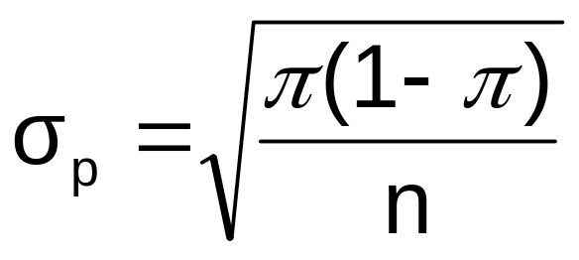
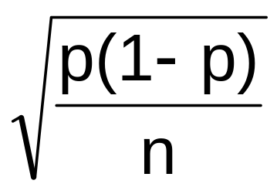
Confidence Intervals for the
Population Proportion, π
(continued)
Recall that the distribution of the sample proportion is approximately normal if the sample size is large, with standard deviation
We will estimate this with sample data:
DCOVA

Slide 37
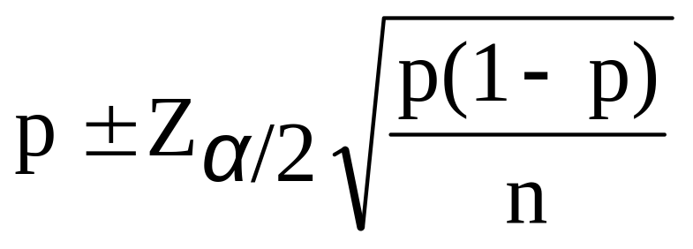
Confidence Interval Endpoints
DCOVA
Upper and lower confidence limits for the population proportion are calculated with the formula
where
  Z_{α/2} is the standard normal value for the level of confidence desired
  p is the sample proportion
  n is the sample size
Note: must have np > 5 and n(1-p) > 5

Slide 38

Example
DCOVA
A random sample of 100 people shows that 25 are left-handed.
Form a 95% confidence interval for the true proportion of left-handers

Slide 39
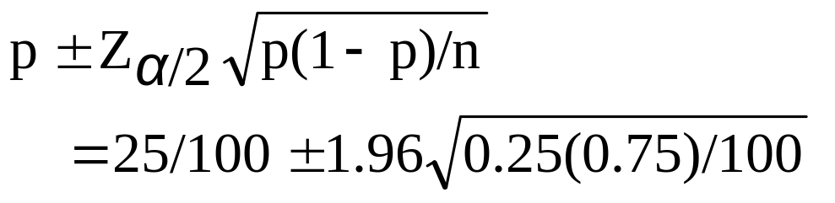
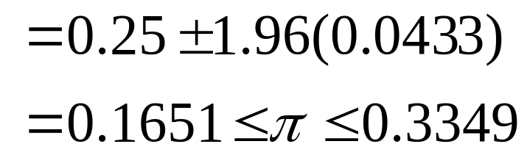
Example
DCOVA
(continued)
A random sample of 100 people shows that 25 are left-handed. Form a 95% confidence interval for the true proportion of left-handers.

Slide 40
Interpretation
DCOVA
We are 95% confident that the true percentage of left-handers in the population is between
16.51% and 33.49%.
Although the interval from 0.1651 to 0.3349 may or may not contain the true proportion, 95% of intervals formed from samples of size 100 in this manner will contain the true proportion.

Slide 41
Determining Sample Size
DCOVA
Determining
Sample Size
For the
Mean
For the
Proportion

Slide 42
Sampling Error
DCOVA
The required sample size can be found to reach a desired margin of error (e) with a specified level of confidence (1 - α)
The margin of error is also called sampling error
  the amount of imprecision in the estimate of the population parameter
  the amount added and subtracted to the point estimate to form the confidence interval

Slide 43
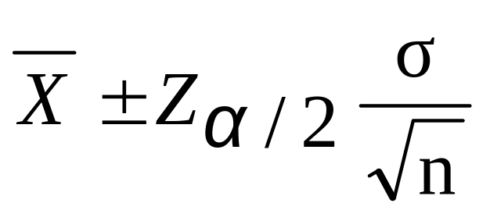
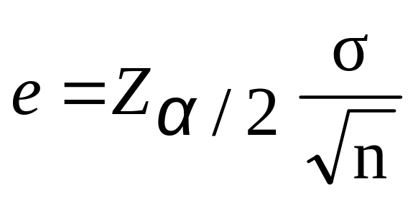


Determining Sample Size
DCOVA
Determining
Sample Size
For the
Mean
Sampling error (margin of error)

Slide 44
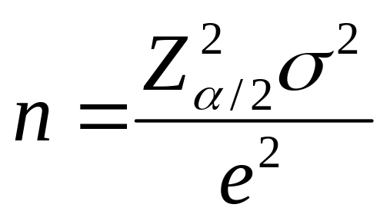
Determining Sample Size
(continued)
DCOVA
Determining
Sample Size
For the
Mean
Now solve for n to get

Slide 45
Determining Sample Size
(continued)
DCOVA
To determine the required sample size for the mean, you must know:
  The desired level of confidence (1 - α), which determines the critical value, Z_{α/2}
  The acceptable sampling error, e
  The standard deviation, σ

Slide 46
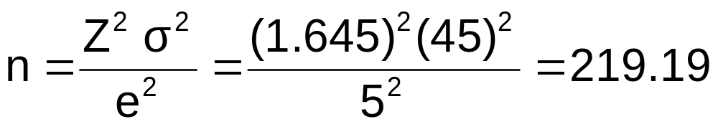
Required Sample Size Example
DCOVA
If σ = 45, what sample size is needed to estimate the mean within ± 5 with 90% confidence?
So the required sample size is n = 220
(Always round up)

Slide 47
If σ is unknown
DCOVA
If unknown, σ can be estimated when using the required sample size formula
  Use a value for σ that is expected to be at least as large as the true σ
  Select a pilot sample and estimate σ with the sample standard deviation, S

Slide 48
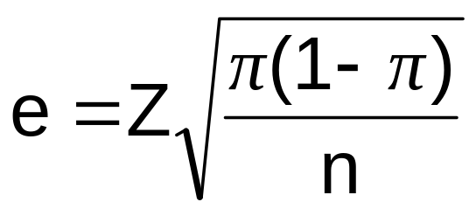
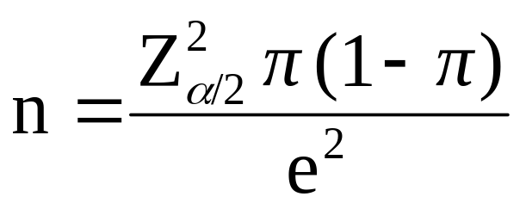
Determining Sample Size
(continued)
Determining
DCOVA
Sample Size
For the
Proportion
Now solve for n to get

Slide 49
Determining Sample Size
(continued)
DCOVA
To determine the required sample size for the proportion, you must know:
  The desired level of confidence (1 - α), which determines the critical value, Z_{α/2}
  The acceptable sampling error, e
  The true proportion of events of interest, π
    π can be estimated with a pilot sample if necessary (or conservatively use 0.5 as an estimate of π)

Slide 50
Required Sample Size Example
DCOVA
How large a sample would be necessary to estimate the true proportion of defectives in a large population within ±3%, with 95% confidence?
(Assume a pilot sample yields p = 0.12)

Slide 51
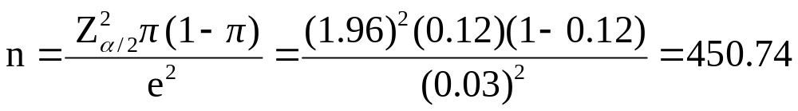
Required Sample Size Example
(continued)
Solution:
For 95% confidence, use Z_{α/2} = 1.96
e = 0.03
p = 0.12, so use this to estimate π
DCOVA
So use n = 451

Slide 52
Ethical Issues
A confidence interval estimate (reflecting sampling error) should always be included when reporting a point estimate
The level of confidence should always be reported
The sample size should be reported
An interpretation of the confidence interval estimate should also be provided

Slide 53
Chapter Summary
In this chapter we discussed:
The construction and interpretation of confidence interval estimates for the population mean and the population proportion
The determination of the sample size necessary to develop a confidence interval for the population mean or population proportion

Slide 54
Chapter 8
On Line Topic: Bootstrapping

Slide 55
Bootstrapping Is A Method To Use When Population Is Not Normal
DCOVA
To estimate a population mean using bootstrapping, you would:
  Select a random sample of size n without replacement from a population of size N.
  Resample the initial sample by selecting n values with replacement from the initial sample.
  Compute X from this resample.
  Repeat steps 2 & 3 m different times.
  Construct the resampling distribution of X.
  Construct an ordered array of the entire set of resampled X’s.
  In this ordered array find the value that cuts off the smallest α/2(100%) and the value that cuts off the largest α/2(100%). These values provide the lower and upper limits of the bootstrap confidence interval estimate of μ.

Slide 56
Bootstrapping Requires The Use of Software As Minitab or JMP
DCOVA
Typically a very large number (thousands) of resamples are used.
Software is needed to:
  Automate the resampling process
  Calculate the appropriate sample statistic
  Create the ordered array
  Find the lower and upper confidence limits

Slide 57
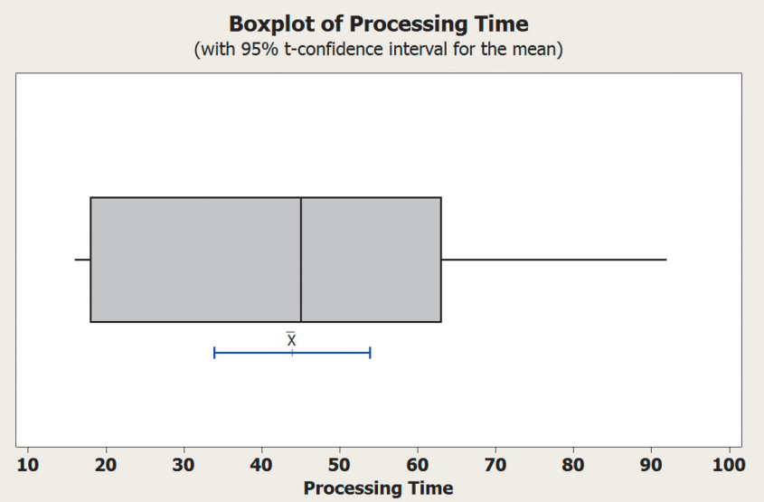
Bootstrapping Example -- Processing Time of Life Insurance Applications
DCOVA
Sample of 27 times taken without replacement from population
73 19 16 64 28 28 31 90 60 56 31 56 22 18 45 48 17 17 17 91 92 63 50 51 69 16 17
From boxplot conclude population is not normal so t confidence interval is not appropriate.
Use bootstrapping to form a confidence interval for μ.

Slide 58
Comparing the original sample to the first resample with replacement
DCOVA
Sample of 27 times taken without replacement from population
73 19 16 64 28 28 31 90 60 56 31 56 22 18 45 48 17 17 17 91 92 63 50 51 69 16 17
The initial bootstrap resample omits some values (18, 45, 50, 63, and 91) that appear in the initial sample above. Note that the value of 73 appears twice even though it appears only once in the initial sample.
16 16 16 17 17 17 17 17 19 22 28 31 31 51 56 56 60 60 64 64 64 64 69 73 73 90 92

Slide 59
The Ordered Array of Sample Means for 100 Resamples
DCOVA
Fifth Smallest
31.5926 | 33.9259 | 35.4074 | 36.5185 | 36.6296 | 36.9630 | 37.0370 | 37.0741
37.1481 | 37.3704 | 37.9259 | 38.1111 | 38.1481 | 38.2222 | 38.2963 | 38.7407
38.8148 | 38.8519 | 38.8889 | 39.0000 | 39.1852 | 39.3333 | 39.3704 | 39.6667
40.1481 | 40.5185 | 40.6296 | 40.9259 | 40.9630 | 41.2593 | 41.2963 | 41.7037
41.8889 | 42.0741 | 42.1111 | 42.1852 | 42.8519 | 43.0741 | 43.1852 | 43.3704
43.4444 | 43.7037 | 43.8148 | 43.8519 | 43.8519 | 43.9259 | 43.9630 | 44.1481
44.4074 | 44.5556 | 44.7778 | 45.0000 | 45.4444 | 45.5185 | 45.5556 | 45.6667
45.7407 | 45.8519 | 45.9630 | 45.9630 | 46.0000 | 46.1111 | 46.2963 | 46.2963
46.3333 | 46.3333 | 46.4815 | 46.6667 | 46.7407 | 46.9630 | 47.0741 | 47.2222
47.2963 | 47.3704 | 47.4815 | 47.4815 | 47.5556 | 47.6667 | 47.8519 | 48.5185
48.8889 | 49.0000 | 49.2222 | 49.4444 | 49.4815 | 49.4815 | 49.6296 | 49.6296
49.7407 | 50.2963 | 50.4074 | 50.5926 | 50.9259 | 51.4074 | 51.4815 | 51.5926
51.9259 | 52.3704 | 53.4074 | 54.3333
Fifth Largest

Slide 60
Finding a 90% Bootstrap CI for The Population Mean
DCOVA
To find the 90% CI for 100 resamples we need to find the 0.05(100) = 5th smallest and the 5th largest values.
From the table the 5th smallest value is 36.6296 and the 5th largest value is 51.5926.
The 90% bootstrap CI is (36.6296, 51.5926)

Slide 61
Topic Summary
In this topic we discussed
The concept of bootstrapping.
When bootstrapping might be appropriate to use.
How to use bootstrapping to form a confidence interval for a population mean.

